Slide 1
Basic Concepts of a computer Hardware
Lecturer: Kamanda Innocent

Slide 2
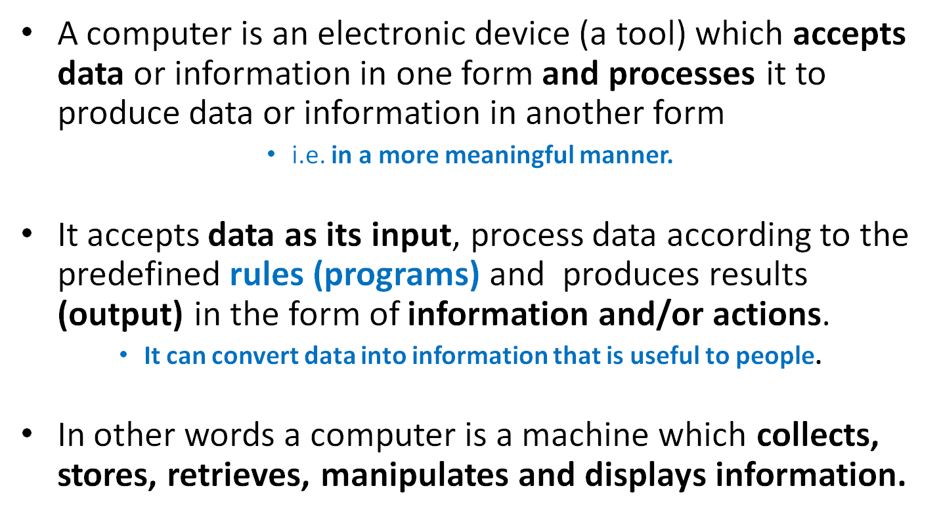
1. Introduction To computer & Windows

Slide 3
A computer is a fabulous instrument that turns human inputs into electronic information that it then can store or share/distribute through various output devices.

Slide 4
A complete computer system has four distinct parts:
    Hardware
    Software
    Data
    User

Slide 5
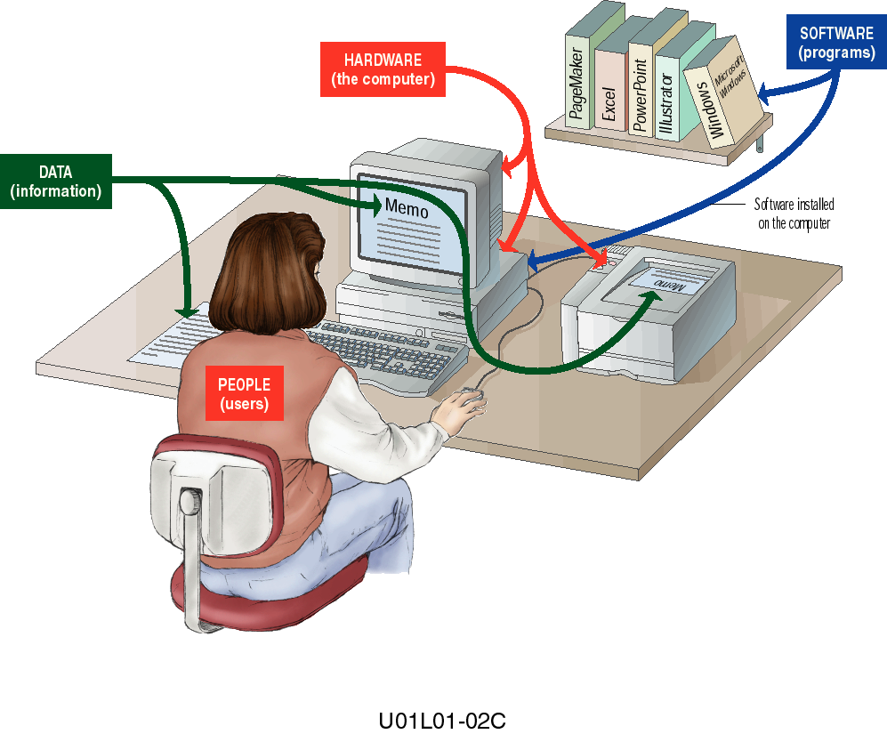
Illustration of Main Parts of a computer system

Slide 6
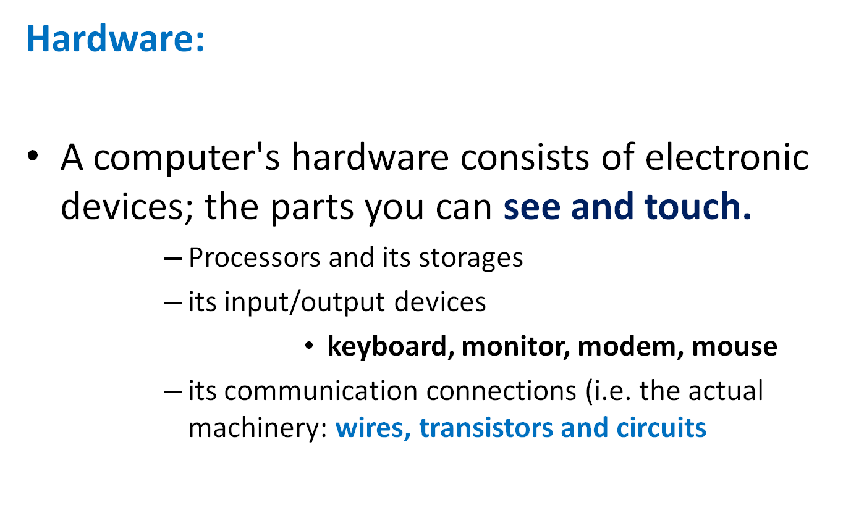

Slide 7
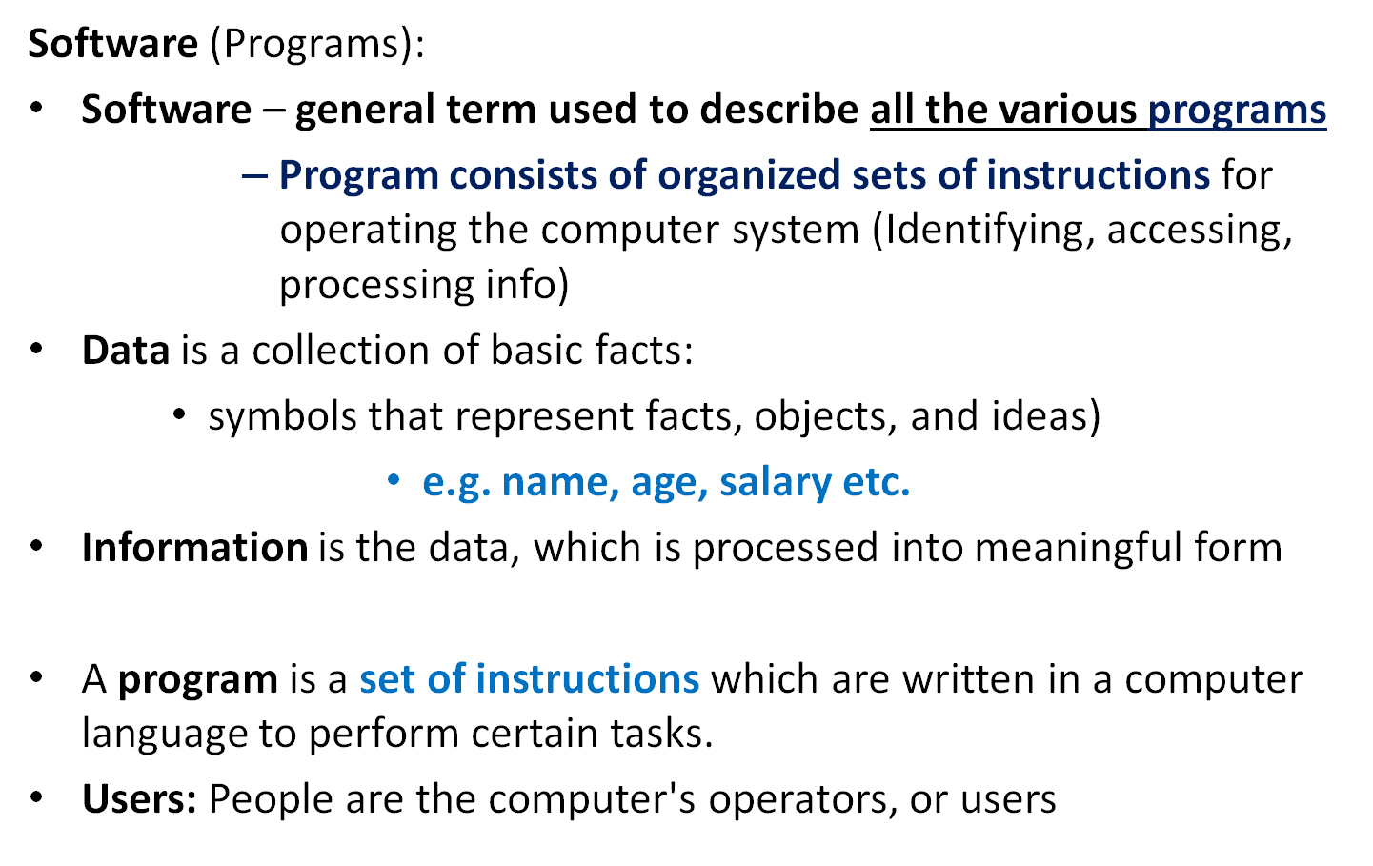

Slide 8
Main parts(components) of a Computer-Processing model
Input
Via keyboard, mouse or microphone
Processing
The information is digitized, becoming a simple code that the computer can store
Storage
The information is stored as a part of the computer’s memory
Output
Information is shared via monitor, printer, speakers or projector
Further Processing
If required, the information is edited or enhanced with input from the user

Slide 9
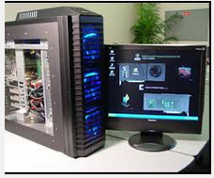
Types of Computers
They are classified by their size, power, capacity, speed and memory.
Supercomputers
    Most powerful computers.
    They are used for problems
    requiring complex calculations.
    An extremely faster computer
    that can perform hundreds of millions of instructions per second.
    Big size and expensive; Hence, relatively rare

Slide 10
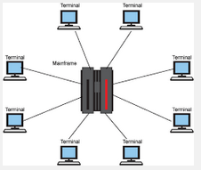
Mainframe computers
    Can support hundreds or thousands of users simultaneously, handling massive amounts of input, output, and storage.
Minicomputers
    Usually have multiple terminals .
    Are Multiprocessing systems (more than one process at a time) capable of supporting from 4 to about 200 users simultaneously.

Slide 11
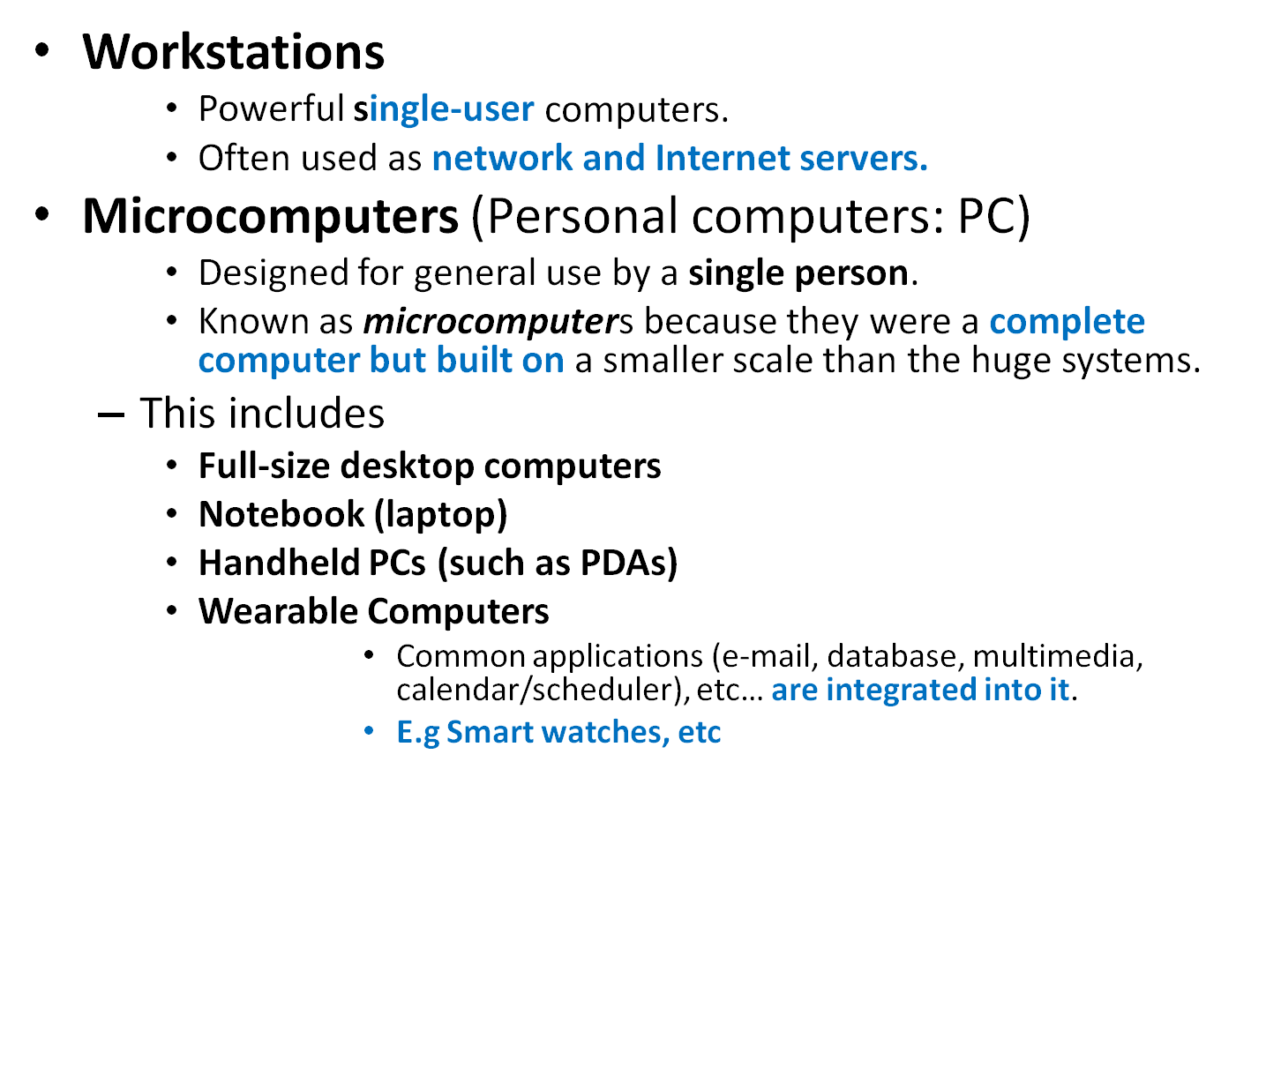
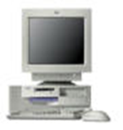
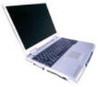

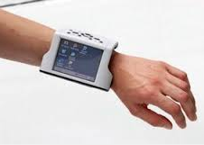

Slide 12
Computer usage
At home,
    PC is used for business (e.g. word processing),
    entertainment (e.g. music composition, greeting cards), gaming
    Education ,etc.
At work :
    Business company
    Education (e-learning)
    Network management, web browser, etc.
As a mobile user
    you can use a portable computer for business, e-mail etc.
Etc

Slide 13
Advantages/Disadvantages of Computers
Advantages
    Speed:
    Accuracy:
    Storage & Retrieval
    Automation - Due to its ability to follow a set of instruction
    Low cost (services)
    High volumes- Due to speed of execution and storage facilities
    Repetitive Operations – actions/execution based on a set of instructions
    ets
Notes:
High volumes: Due to speed to execution and storage facilities the computer is ideal for jobs of high volume.

Slide 14
Disadvantages
    Unemployment
    It needs trained people
    Expensive,
    Health impact
    etc

Slide 15
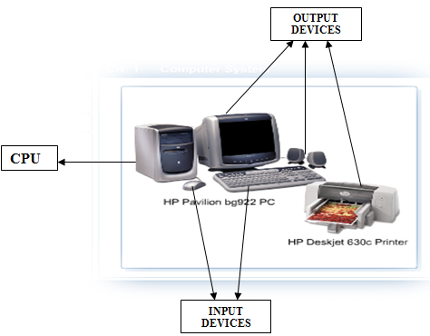
Functions of computer components
Categorized of hardware devices: •Processor
•Memory
•Input and output (I/O) devices
•Storage devices

Slide 16
Central Processing Unit (CPU):
    The heart of the computer
    Responsible for executing instructions
Memory: to store temporarily data and programs.
Input devices: Usually a keyboard and mouse, scanner
    Allow data and instructions to enter a computer.
Output devices: A display screen, printer, or other devices
    Allow results (processed data) to be displayed.
Mass storage device: Allows a computer to permanently retain large amounts of data. Common mass storage devices include disk drive and tape drives

Slide 17
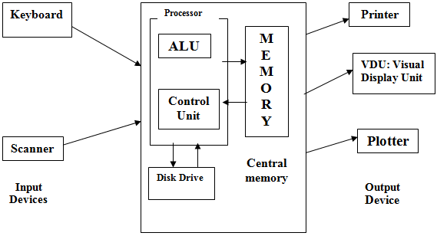
Structural diagram of a computer

Slide 18
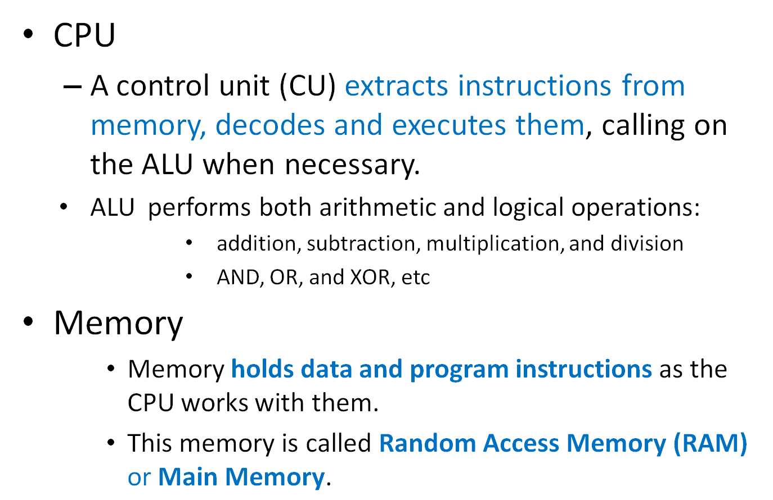

Slide 19
Memory is measured in byte
    1 byte=8 bits; (bit, for Binary digit: 1 or 0)
Storage Term | Approximate Number of Bytes | Exact Number of bytes
Kilobyte (KB) | 1 thousand | 2¹⁰ or 1,024
Megabyte (MB) | 1 million | 2²⁰ or 1,048,576
Gigabyte (GB) | 1 billion | 2³⁰ or 1,073,741,824
Terabyte (TB) | 1 trillion | 2⁴⁰ or 1,099,511,627,776
Petabyte (PB) | 1 quadrillion | 2⁵⁰ or 1,125,899,906,842,624
Exabyte (EB) | 1 quintillion | 2⁶⁰ or 1,152,921,504,606,846,976

Slide 20
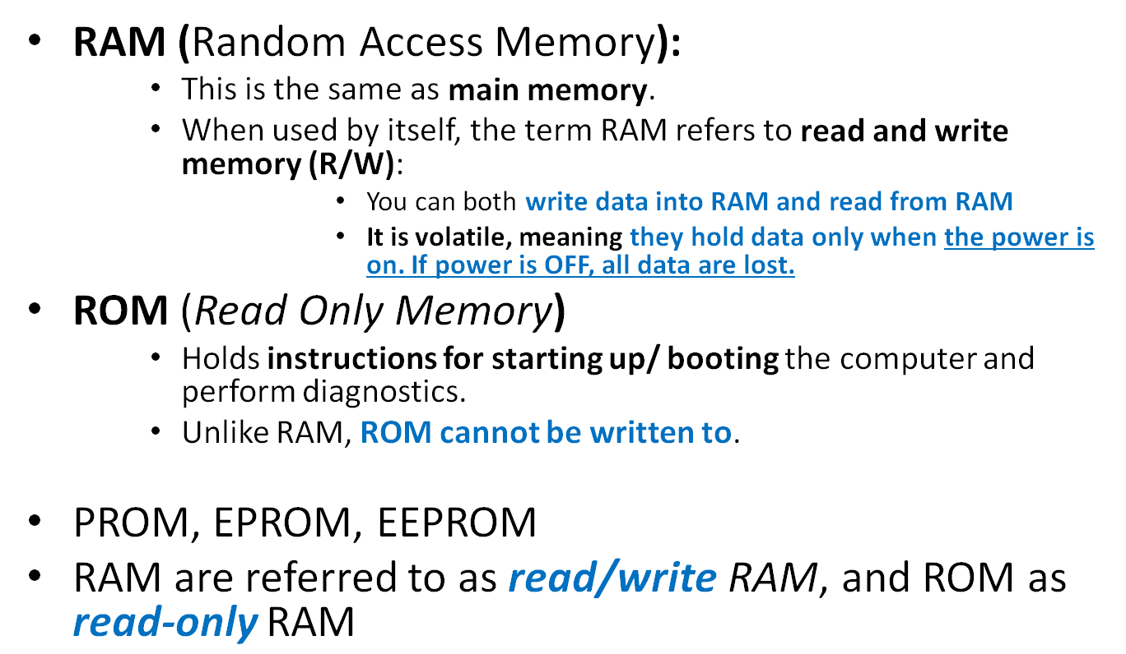
Different Types of Memory:
Notes:
RAM vs. Hard Drive Memory
Both RAM and hard drive memory are referred to as memory, which often causes confusion. RAM stands for Random Access Memory. Physically, it is a series of chips in your computer. When your computer is turned on, it loads data into RAM. Programs that are currently running, and open files, are stored in RAM; anything you are using is running in RAM somewhere. As soon as the electricity to the RAM is cut, it forgets everything; that's why an unsaved document is lost if the computer locks up or there is a power failure. When you save a document it goes on a hard drive, or another type of media storage device. Typically, this type of storage is magnetic, and does not depend on electricity to remember what is written on it. However, it's much slower than RAM. The computer can access anything stored in RAM nearly instantly. Things on the hard drive need to be located, read and sent to RAM before they can be processed. If your computer says you are low on disk space you have too many programs or files on your computer. To correct this, you will need a new hard drive, or will need to uninstall unused programs or delete unneeded files off the computer. If your computer says you are low on memory, you have too many programs running, or your computer does not have the RAM needed to run the software you want to. Restarting your computer will clear the RAM and usually clears up 90% of low memory errors. If your computer has more RAM than the programs minimum requirements, and restarting the computer does not solve the problem, the error could be caused by a buffer overflow, or another technical issue that is outside the scope of this tutorial.
Source: http://www.lehigh.edu/~inimr/computer-basics-tutorial/ramvsdiskspacehtm.htm
The difference between a PROM and a ROM is that a PROM is manufactured as blank memory, whereas a ROM is programmed during the manufacturing process. To write data onto a PROM chip, you need a special device called PROM programmer or PROM burner.

Slide 21
Input and Output (I/O) devices

Slide 22
Input is any data or instructions provided to the computer by a person, the environment, or another computer.
    These are Unprocessed data or instructions
    They include unprocessed:
        Text: words and symbols;
        Numbers
        pictures;
        audio signals from a microphone;
        signals from another computer;
        temperature,
        speed,
        pressures
        Video, etc
Once these input data are in memory, the computer interprets and executes instructions to process them and converts them into information
Instructions are the steps that tell the computer how to perform a particular task.
A program is a series of instructions that tells the computer what to do and how to do it.

Slide 23
Input device
  accepts data and instructions from the user or from another computer system.
  Is any hardware component that allows users to enter data or instructions (programs, commands) into a computer.
Popular input devices
    Keyboard
    Mouse
    Scanner
    Microphone
    Digital camera

Slide 24
Keyboard
A computer keyboard is an input device that contains alpha-numeric keys you press to enter data into the computer.
Desktop computer keyboards typically have from 101 to 105 keys.
Some keyboards are connected to the system by cables and others are cordless.

Slide 25
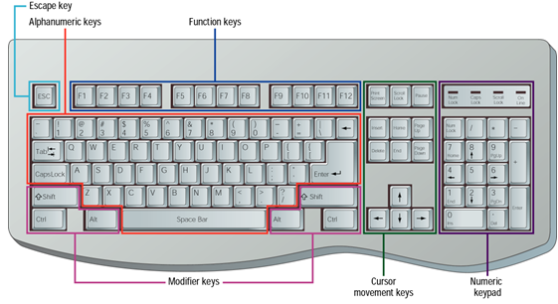
Keys classification of computer keyboards: Alphanumeric keys, Numeric keypad, Special keys (function keys, modifier keys and Cursor-movement keys)

Slide 26
Mouse
A mouse is a pointing device.
It is the most widely used pointing device on a computer.
To control the movement of a graphical pointer on the screen.
It can also be used to do commands, draw, and perform other types of input tasks

Slide 27
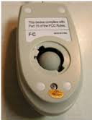
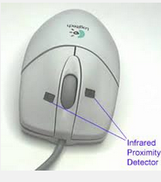
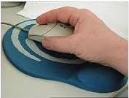
Mechanical mouse: It has a rubber or metal ball on its underside that can roll in all directions.
Rubber ball
mouse pad

Slide 28
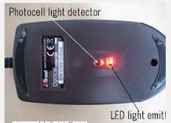
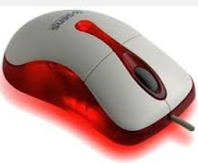
Optical mouse:
No moving mechanical parts inside.
It uses device that emits and senses light to detect mouse’s movement.
No need for mouse pad.

Slide 29
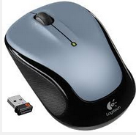
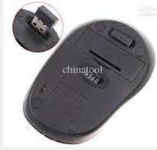
Cordless mouse:
Is not physically connected at all.
They are battery-powered devices that transmit data using wireless technology, such as radio waves or infrared light waves.

Slide 30
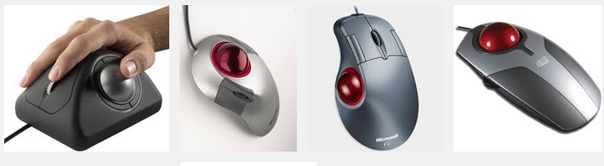
Trackballs
A trackball is like a mouse turned upside-down. The thumb is used to move the exposed ball and fingers to press the buttons.

Slide 31
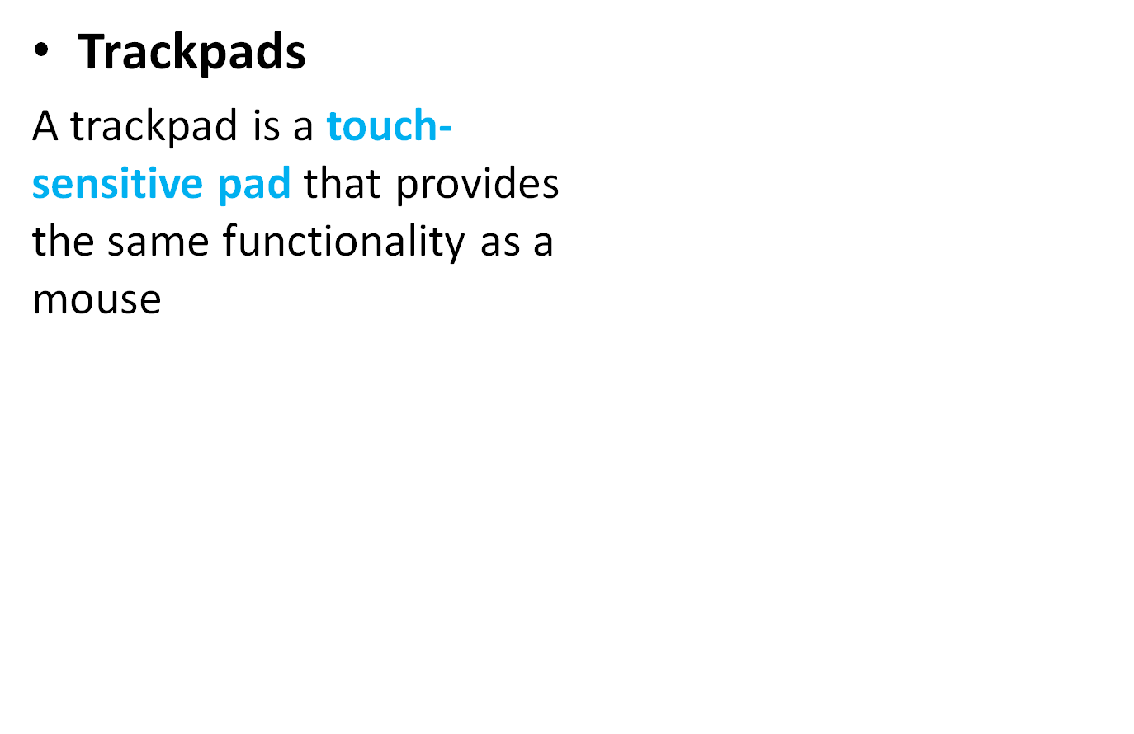
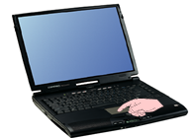
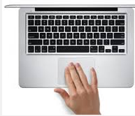
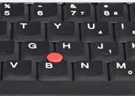
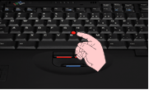
Integrated Pointing Devices: An integrated pointing device is a small joystick built into the keyboard.
e.g. Laptops

Slide 32

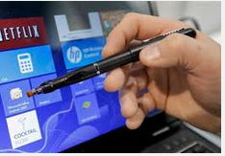
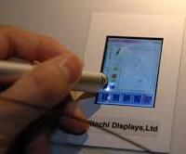
A light pen is a handheld input device that can detect the presence of light.
With a pen-based system, you use an electronic pen to write on the screen and choose commands

Slide 33
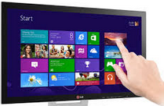
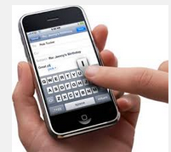
Touch-screen:
The system accepts input directly through the monitor.
Touch screens use sensors to detect the touch of a finger.
No use of a keyboard or mouse.
Computer
Smartphone

Slide 34
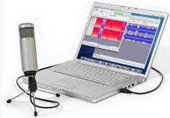
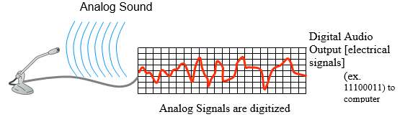
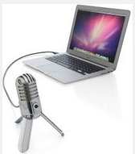
Microphones
Voice recognition also called speech recognition, is the computer’s capability of distinguishing spoken words.
Voice recognition programs do not understand speech.
They recognize a vocabulary of pre-programmed words.

Slide 35

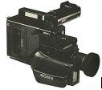
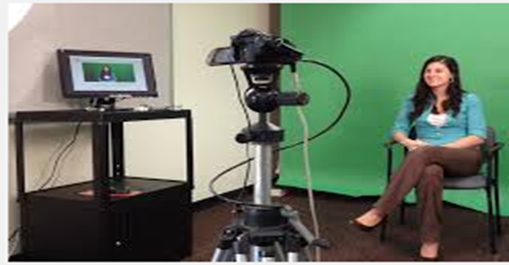
Video Input
Video input is the process of capturing full motion images into a computer and storing them.
Web cams
Today, most computers have Web cameras(e.g. Laptop)

Slide 36

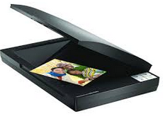
Scanner
An optical Scanner, usually called a scanner, is a light-sensing input device that reads printed text and graphics and then translates the results into a form which can be processed by the computer.
And others, …..
Flatbed Scanner:
Sheet-fed Scanner

Slide 37
Output Devices
Output is the result produced by a computer i.e. data that has been processed into a useful form.
Output device
    Returns the processed data back to the user or to another computer system, but in another form.
    It is any hardware component that displays, prints, or transmits the results of processing.
E.g. Display devices, printers, speakers, headsets and so on.

Slide 38
There are 4 basic categories of outputs:
    Text and Symbols
    Graphics
    Audio and
    Video

Slide 39
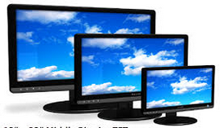
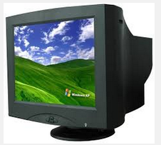
Display devices
Monitor/ Screen/ VDU (video display unit)
A display device, or simply display is an output device that visually conveys text, graphics and video information.
Cathode ray tube (CRT) monitor
Flat-panel displays also called LCD monitor

Slide 40
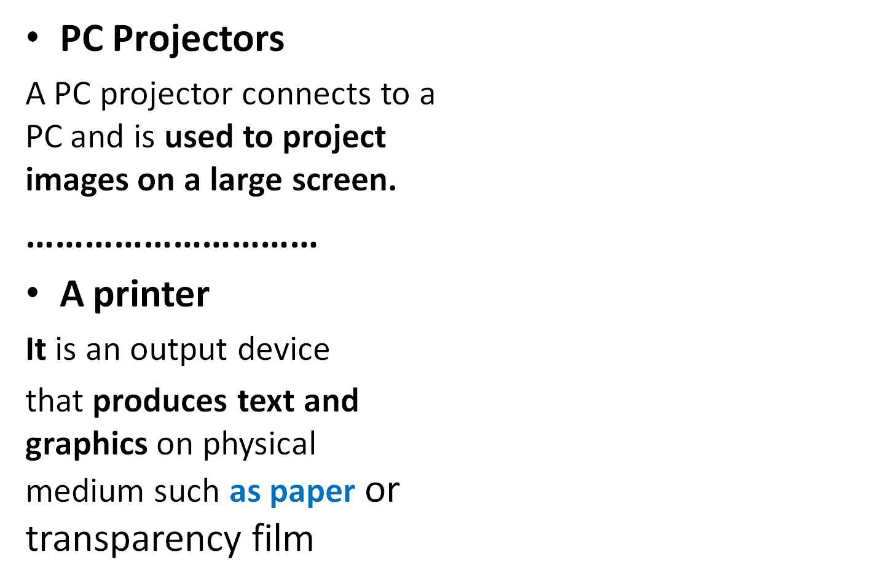
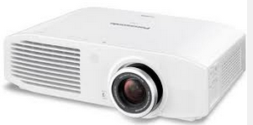
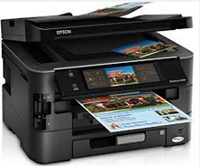
All in one (multifunction) printer: printing, faxing, scanning, and copying, stapling.

Slide 41
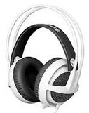
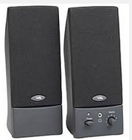
Speakers and Headsets
An audio output device is a component for a computer that produces, music speech, or other sounds such as beeps.
Two commonly used audio output devices:
    Speakers
    Headsets

Slide 42
Storage Devices
A storage medium (secondary storage) is the physical material on which a computer keeps data, instructions and information
Storage device holds data, instruction, and information for future use.
It is the hardware that writes data to or reads data from a storage medium.
    E. g: A floppy disk drive and Hard disk are drive storage devices.
Storage devices hold data not currently being used by the CPU
The data being processed are stored in Memory (temporary).

Slide 43
Writing
is the process of transferring data, instructions and information from memory to storage medium.
Reading
is the process of transferring these items from storage medium into memory

Slide 44


Three Types of Storage devices (primary):
(1)The primary types of magnetic storage are:
They have numerous platters coated with magnetic material for data storage.
E.g:
    Diskettes (floppy disks): read and write to diskettes.
    Hard disks
Currently, not very used

Slide 45
(2)The primary types of optical storage are:
Optical drives use a laser to read or write information to a separate storage media
These are:
CD-ROM (Compact Disk Read-Only Memory);
DVD-ROM (Digital Video Disk Read-Only Memory
CD - Recordable (CD-R)
CD-Rewritable (CD-RW).
Notes:
CD-RW (Compact Disc-Read/Writable) is a digital optical disc storage format. A CD-RW disc is a compact disc that can be written, read arbitrarily many times, erased and written again

Slide 46
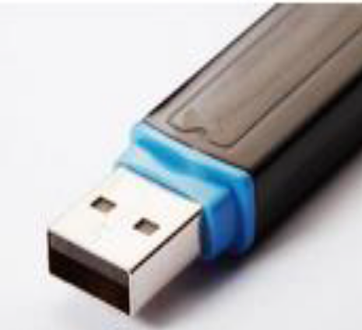
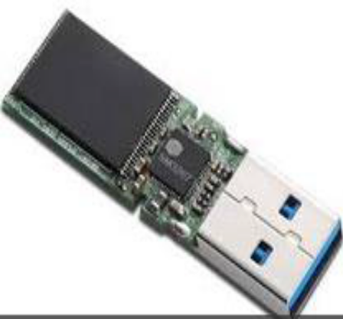
(3) Solid State storage devices
Solid state memory devices such as flash drives are non-volatile storage, which essentially means they do not require constant power to retain the information.
Flash drives draw power from your computer when they are plugged in, and require no additional power supply.

Slide 47
Software Types
Software
It is a set of electronic instructions that tells the computer how to do a certain task.
Program
A set of instructions performing a particular task.
When a computer is using a particular program, it is said to be running or executing the program.
Notes:
1. Software is a broad term that covers computer programs as well as the components that it needs to run while program is a term used to describe any code that is used to run a device
2. Programs existed before software
3. Software typically consists of files while programs can be files or even punch card (card that contains all commands)
4. Software holds files of programs
5. Software is a very broad term that is used to identify programs, data, and other related files that are used to accomplish certain tasks in a computer or any other device that is performs a computing task. In this sense, we can say that even a program is also a software. But in the broader meaning of the word, a program is any set of instructions that are executed by a machine.
Source: http://www.differencebetween.net/technology/difference-between-software-and-program/

Slide 48
System software
exists primarily for the computer itself, to help the computer to perform specific functions.
consists of the programs that control or maintain the operations of the computer and its devices.
Two types of system software:
    Operating systems (OS),
    Utility programs.

Slide 49
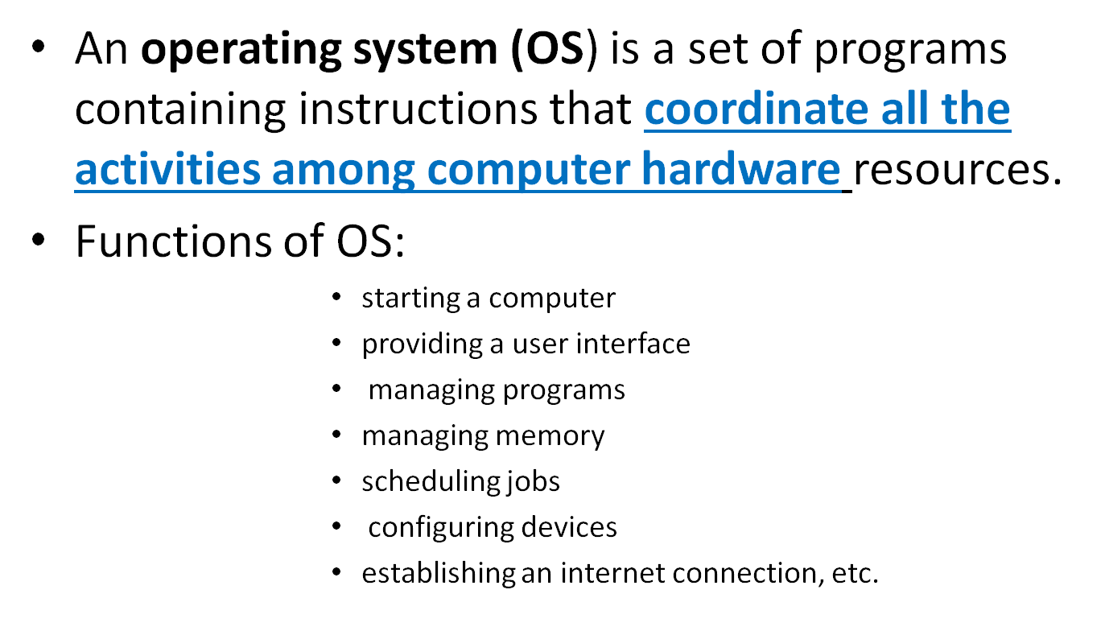
Operating systems
Notes:
Source: http://www.computerhope.com/os.htm
An operating system or OS is a software on the hard drive that enables the computer hardware to communicate and operate with the computer software. Without a computer operating system, a computer and software programs would be useless

Slide 50
Types of Operating Systems
A stand-alone operating system:
is a complete operating system that works on a PC computer.
They include networking capabilities which allow users to set up a small network.
e.g. : DOS, Windows XP, Mac OS X, windows 7, 8, 8.1, 10, etc.

Slide 51
Network Operating System (NOS)
    A NOS typically resides on a server.
    A NOS is an OS that is designed specifically to support a network.
    designed specifically to support all sizes of networks, including medium to large-sized businesses and web servers
    e.g. Windows server 2003, OS/2 Warp Server for e-business
Some stand-alone OS are called client operating systems because they also work in conjunction with a network operating system. Client operating systems can operate with or without a network

Slide 52
Utilities
A utility is a program that performs a task that is not typically handled by the OS.
Some OSs typically include some built-in utilities,
But there are also many stand-alone utility programs are available for purchase.
Some of their categories include:
    File defragmentation
    Data compression
    Antivirus and
    etc

Slide 53
Antivirus program
Computer virus describes a potentially damaging computer program that affects a computer negatively by altering the way the computer works without the user’s knowledge or permission.
To protect the computer against virus attacks, install an Antivirus program and update it frequently.

Slide 54
File compression
A file compression utility reduces the size of a file(s). A compressed file takes up less storage space than original file.
e.g: Winzip/ winrar: for zipping and unzipping files

Slide 55
File and disk defragmentation
Over time, both the file and the hard disk itself become fragmented, and your computer slows down as it has to look in many different places to open a file.
Disk Defragmenter is a tool that rearranges the data on your hard disk and reunites fragmented files so your computer can run more efficiently.

Slide 56
Development Software/ Programming languages
Development softwares:
are programming languages used to develop/write application softwares and Operating systems.
Programming language:
is a set of words, symbols and codes that enables a programmer to communicate instruction to a computer.
e.g: Visual Basic, C, C++, Perl, and Java, etc.
Programmers use a variety of languages and tools to write, or code a program.

Slide 57
Application Software: Some types & Use
Application software tells the computer how to accomplish tasks required by the user such as creating a document or editing a graphic image, etc.
They consists of programs that perform specific tasks for users.
e.g: -MS Office: Word processing programs, spreadsheet software, Presentation programs, Database management,
- Graphics programs, networking software, Web
design tools.
-Communication Software: Browsers, social media, e-mail, etc.

Slide 58
General Precautions
User Security
    Protect user’s files with a username and Password.
    The password (PW) that the user chooses must be kept secret.
    Choose a PW which is difficult to guess by other users

Slide 59
Backups
Another aspect of security, is safe guarding data stored on the computer against computer malfunction or device failure.
It is important to take regular backups of data on media which is external to the computers.
Backup means creating or making a duplicate version of any file:
    That you don’t want to lose.
    That you want to keep historical data for future use.

Slide 60
Power Failure: UPS (Uninterruptible Power Supply). An UPS is a power backup system UPS is used when there is a power failure or power interruptions.
Hardware Failure: depends on the component that fails, a hard disk may also fails; then you lose your data, if no back up done.
Operator error: this refers to a mistake made by a computer user.
Software failure (Computer viruses): viruses are programs written by people to create disastrous effects like deleting important information, corrupting software and data, displaying funny things on the screen, while users are working.

Slide 61
Routine care and Maintenance (Handling)
Computers have to be kept in dust free environments.
A normal office air conditioning system maintains rooms dust free.
User should avoid eating food, or having drinks, or smoking near computers
All these leave behind tiny particles which are dangerous to the proper functioning of computers, Storage devices, like disks

